Slide 1
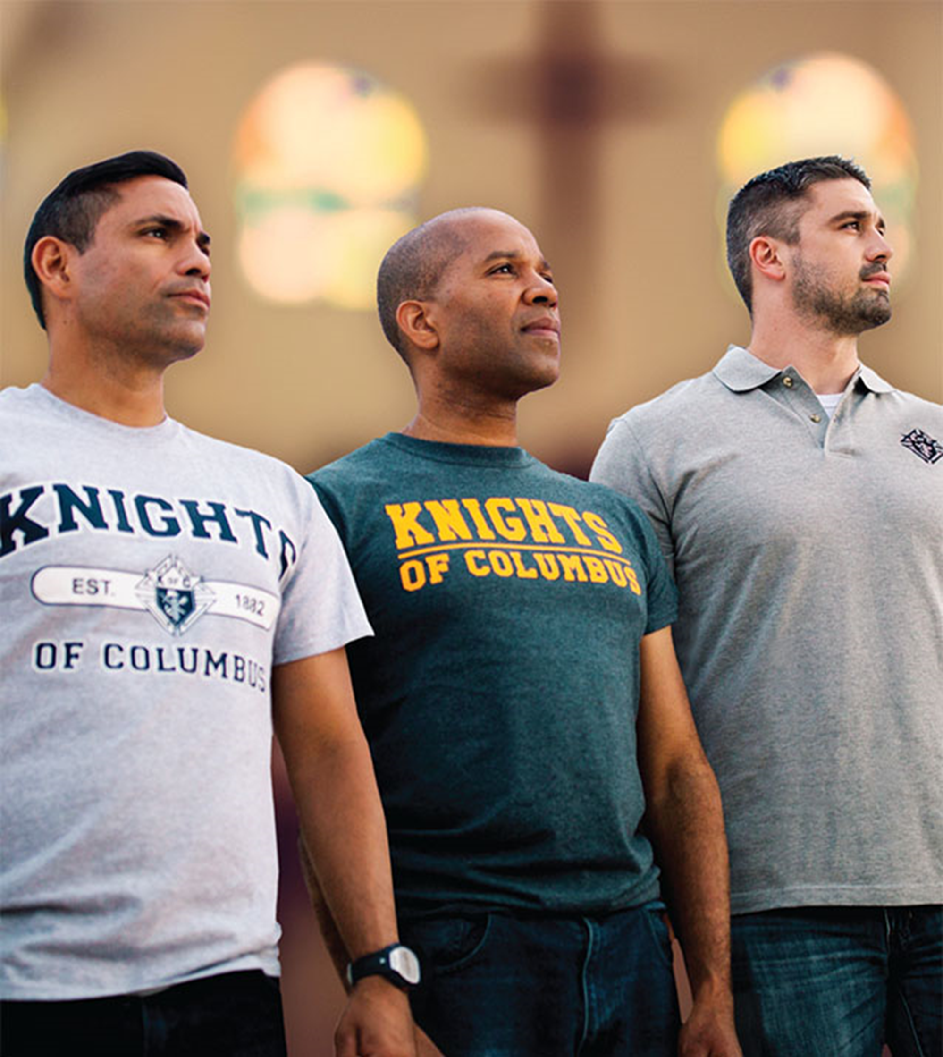
Membership Retention DD’s Getting Involved

Slide 2
Introduction/Overview
Managing The Membership Bucket
Its Time to Look into the Mirror
It’s all about Them
Communicate…Communicate…Communicate
Best Practice Retention Strategies

Slide 3
The Membership Bucket
Membership is like a bucket under a faucet of water
Relevant and meaningful engagement early will prevent leaks later
Retention is just important as recruitment
Feeling Neglected
Un-met Expectations
Notes:
To demonstrate council membership growth and retention; imagine a bucket filling with water. Your council is the bucket and the water coming from the faucet represents the in-flow of new members. Water is both life-giving and symbolic. No one can survive without water, and water represents new life! Without new members, your council can not survive, for long! The bucket you see has some leaks, and is loosing water! So regardless of the amount of water coming from the faucet, and into the bucket, it is still losing water!
When the faucet is on full blast, meaning your council is actively recruiting new members and growing exponentially, then the leaks are less noticeable. Even though the water may continue to rise, council officers need to be aware of the root cause. If the faucet is turned off, it won’t be very long and your bucket will be near empty. As the water flow will varies your leaks will be more or less noticeable.
You should take actions that are focused on increasing the flow of water, and ways of plugging those holes! The more that holes that are plugged, the more water stays in the bucket. The key is to understand the core reason you are losing members.
Now, here's a chilling thought. What happens to your bucket when the flow of water slows down, and your holes get larger? Now, your council is quickly at a crisis point. Officers and members must come together and determine a course of action that plugs the holes, and increases the water flow into the bucket. The answer is generally, a proactive approach with charitable outreach programs, which our members find attractive. Council officer time and energies need to focus on fixing these holes. At each function, program or project someone must be in charge of keeping track of who was helping out. By doing so, your council will build a book of knowledge on what events attract which members, and it will help officers learn about improving relationships with members.

Slide 4
Look into the Mirror
As a DD, how many times have you heard these…………
“We cant get anyone to volunteer”
“It’s the same 6 to 8 guys at every event”
“Nobody want to join our Council”
“We tapped out the Parish, there's nobody left to recruit”
“We don’t have the manpower for those activities”
“We cant do those programs Supreme wants us to do”

Slide 5
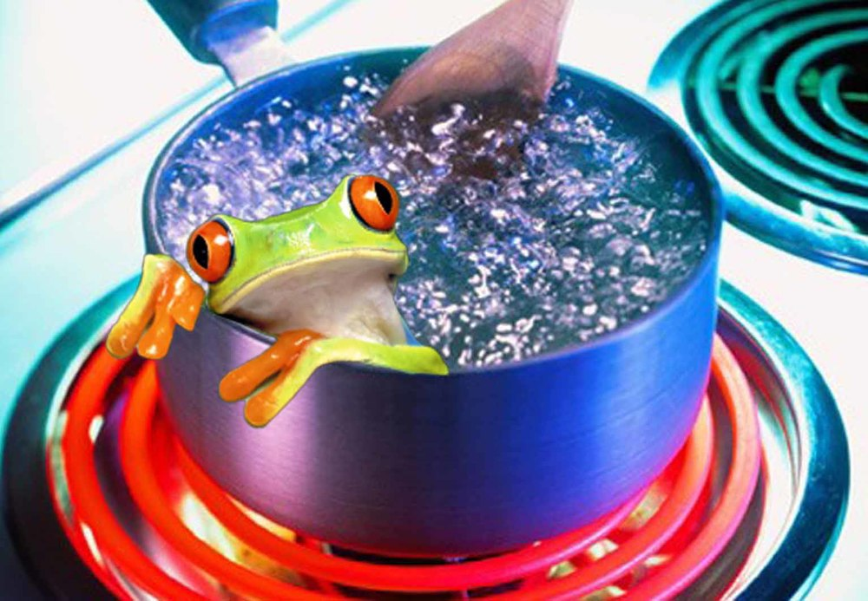
Look into the Mirror
Sometimes the Council is their own worst enemy!
If a frog is placed in boiling water, it will make every effort to jump out to save its life.
If its placed in cool water that is slowly heated, it will not perceive the danger and will be cooked to death.

Slide 6
Look into the Mirror
“The Boiling Frog story is often used as a metaphor for the inability of people to react to significant changes or events which have become commonplace”

Slide 7
Look into the Mirror
Are your Councils boiling to death?
Do they not perceive the danger they are in?
“Its so sad to me that Councils get so upset about changing the programs they have done for years that aren’t working”

Slide 8
Look into the Mirror
So what must we do?
As a DD, you need to help your councils jump out of the boiling water before its too late!
To begin, we need to understand why a member joined and what he expects from his membership in the Order.

Slide 9
Understanding What They Want out of Membership
It all starts with the first conversation
Everyone’s reason for joining is personal. Find out what it is
Ask them why they joined and what they want to get out of it:
Is it charitable? (Volunteering with family)
Do they want to give back to their local communities? (Helping the elderly or disabled)
Do they want to be part of a fraternal group of catholic men like them?
Is it for spiritual reasons? (Prayer groups?)

Slide 10
Understanding What They Want out of Membership
Nobody joined to do nothing
Believe this or not, they didn’t join to attend meetings either
If we aren’t offering something they want, they won’t come back…would you?
Dig deep and get to the true reason they joined

Slide 11
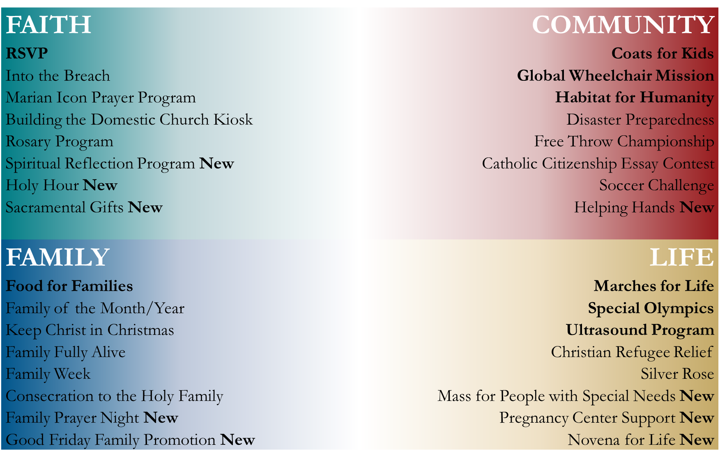
There’s Something for Everyone – Find Out What it is

Slide 12
Develop a Relationship…And Make it Relevant
Make it Personal:
Assign a member that works to understand the new member’s needs.
Engagement: Have the member develop a personal relationship
Communicate 1:1 regularly on their terms
Frequency and method (email, phone, f2f, coffee)
Meaningfulness:
Be open to new ideas they have
Suggest and encourage participation in programs they're interested in
Notes:
Membership retention IS, an active and ongoing process of engaging each individual member in your council.
This involves contact with your council members and inviting or encouraging them to participate in council action, particularly in charitable outreach. Members find these activities to have the most meaningful “personal” outcomes.
This Retention process must be an ongoing and proactive effort to have long term successful outcomes. It doesn’t matter whether a member is 18 or 80, the process is the same. The processes we outline in this course are the foundation for inspiring meaningful interaction between the council and it’s membership.
Creating a fraternal bond between members, and among members is a great step in the right direction. To create this bond we must understand, that each member joins to get engaged in Charity, the first principle of our Order. We promise this to each candidate. These charitable outreach projects should engage many members, and their families. This is a great contribution, however, you may never see them at meetings. So this takes a council mind shift.
Membership retention is not a one-size fits all proposition. We will explore some simple approaches that you can use to begin a positive council retention culture. Your understanding of the requirements is the first step.
With just a little structured effort on behalf of council officers, directors, chairmen, you will help your members become what they aspired to be when the joined your council! A better husband, father and Catholic man.

Slide 13
Building a Strong Member Communication Process
Communicate Consistently
Ask them how they like to be communicated to and how frequently
Online surveys (Survey Monkey, Typeform, email, phone, etc.)
Email a survey and compile results
Determine what works best for your council
Email, Newsletter, Blog, Bulletins, council trifold brochures
Create an annual communication schedule and stick to it
Focus on consistency over quantity
Ensure published (website) information is accurate

Slide 14
Building a Strong Member Communication Process
Create a Council Engagement Spreadsheet
Personal membership profile
History of their membership participation
Record notes on their level of engagement
Touch member personally and consistently
Cards and Notes: Birthday, anniversary cards/ joining anniversary, child’s first communion or confirmation
Track what creates a positive reaction
Promote the Council’s Successes

Slide 15
A Retention Committee
The retention committee is the support structure for your council. They keep in touch with the members and make sure they feel ‘part of the team’.
The chairman is responsible for making sure that there is consistent and ongoing outreach to members.
Structure
Chairman (typically the DGK)
Typically one committee member for every ten Knights
All 3 trustees (ideally)
Meet monthly for 1 hour (Best practice)
20 minutes-Member by member review-Update spreadsheet
20 minutes- ID delinquent members
20 minutes Who follows up with who. Action plan to follow up with everyone
Agree to follow up actions with a phone call

Slide 16
Retention Committee Responsibilities
Ensure your Knights are engaged and happy
Touching base, building a meaningful relationship, and keeping track of member’s satisfaction with their membership
Identifying member concerns immediately and helping them find a solution

Slide 17
Managing the ‘Unpaid Dues’ Red Flag
The biggest red flag that a member is losing interest is when he stops paying his dues……….agree?
Build a Process around Managing unpaid dues
Review list of members ID’d as past due
Assign member to contact immediately
Probe in detail to understand level of engagement
Ask what they want to get involved with
Encourage them to participate in a program that fits that desire
Notes:
The “red flag” signal is that the council need to pay closer attention to the activities and welfare of it’s members.
An important thing to realize here is that understanding the events that led up to this decision is a crucial step in understanding how the council failed to engage this member. In order to retain members like this, we need to ensure that we have been paying attention and that we have some idea what led this member to stop paying his dues. Was it from the holes in our bucket earlier, unmet expectations or feeling neglected? Answer these questions, and many others will become evident.
Once the member has stopped paying his dues, it may be very difficult to re-engage him in his council. Swift steps must be taken, which start with reaching out to the member in a personal way, to find out what is going on in his life. Maybe there is a health problem, or job issue, and family member that requires extra attention or extra funding

Slide 18
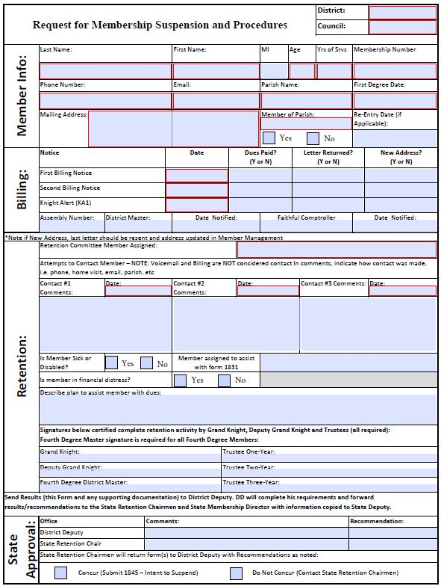
A Best Practice Process for Saving Members
Have the council follow the process
The District Deputies need to stay closely involved

Slide 19
Oregon Retention Process
First and Second Billing Notices are sent to members
After 60 days (30 days first billing cycle + 30 days second billing cycle) Financial Secretary then sends delinquent list to retention committee using the “California Form” Request for Membership Suspension
The Financial Secretary also sends a Knight Alert letter to all delinquent members
Retention committee compiles report using the “California Form” Request for Membership Suspension
District Deputy is notified of Retention results and of all documentation used by Retention Committee
District Deputy notifies State Retention Chairman and conducts due diligence
State Deputy reviews recommendation to determine concurrences
District Deputy provides feedback back to Council on next action, either:
Process Intent to Retain form 1845 on all or some delinquent members; or
Correct identified deficiencies as directed by the District Deputy and State Deputy
After 30 days the Council completes requested action based on feedback (send in form 1845 or other action as requested)
The Intent to Retain Form 1845 is filed with Membership Records at Supreme for the mandatory 60 day hold period, meanwhile council/district continue to work on other action as requested
On or before the 60 day hold period ends, the Council files a Form #100 with Membership Records at Supreme. The Suspension process is complete at this time.
30+30
60 Days
30 Days
60-90
Days

Slide 20
Best Practices For Member Retention
Start your retention efforts on day 1
Reach out early and often
Make it personal. Understand what they want to get out of it
Find out why they joined, do more of it
Build on their original motivation for joining
Help Councils out of the boiling water
Constantly evaluating what works and why it doesn't
Notes:
Here are a few tips to improve your council’s member retention:
Start your retention efforts on day 1
The first day of membership should be the only time you send a mass email with limited personalization. That very first contact can be a welcome format, everything after that should be aimed at maintaining that member. Promote the benefits of membership and keep in contact. You can't begin a retention program six months after his dues has gone unpaid. Your membership retention program starts the instant they agree to become a member.
2. Reach out early and often
For members who fail to find value in their council, it's often due to not fully using the benefits of membership. This could be a lack of knowledge or even just a matter of forgetting. For this reason it's important to stay in touch with your members. You can do this through messages in your online community, phone calls, and through emails. Pay attention to what programs interest him.
3. Make it personal
One-size membership no longer fits all. Members expect a customized approach. As we mentioned earlier, personalization should be a high priority. Consider that personalized subject lines are 22.2% more likely to be opened. This means customizing all types of communications and interactions. If you're not providing an experience that feels personal, you can be sure that your members feel like numbers.
4. Find out why they joined, do more of it
Every member has a reason they joined. Find out what it was! What goal or reason did they have that they thought membership could help them solve. This is really the secret sauce finding ways for the member to participate in “hot button” programs. This is pretty simple and just makes sense.

Slide 21
Questions?
Thank you

