Slide 1
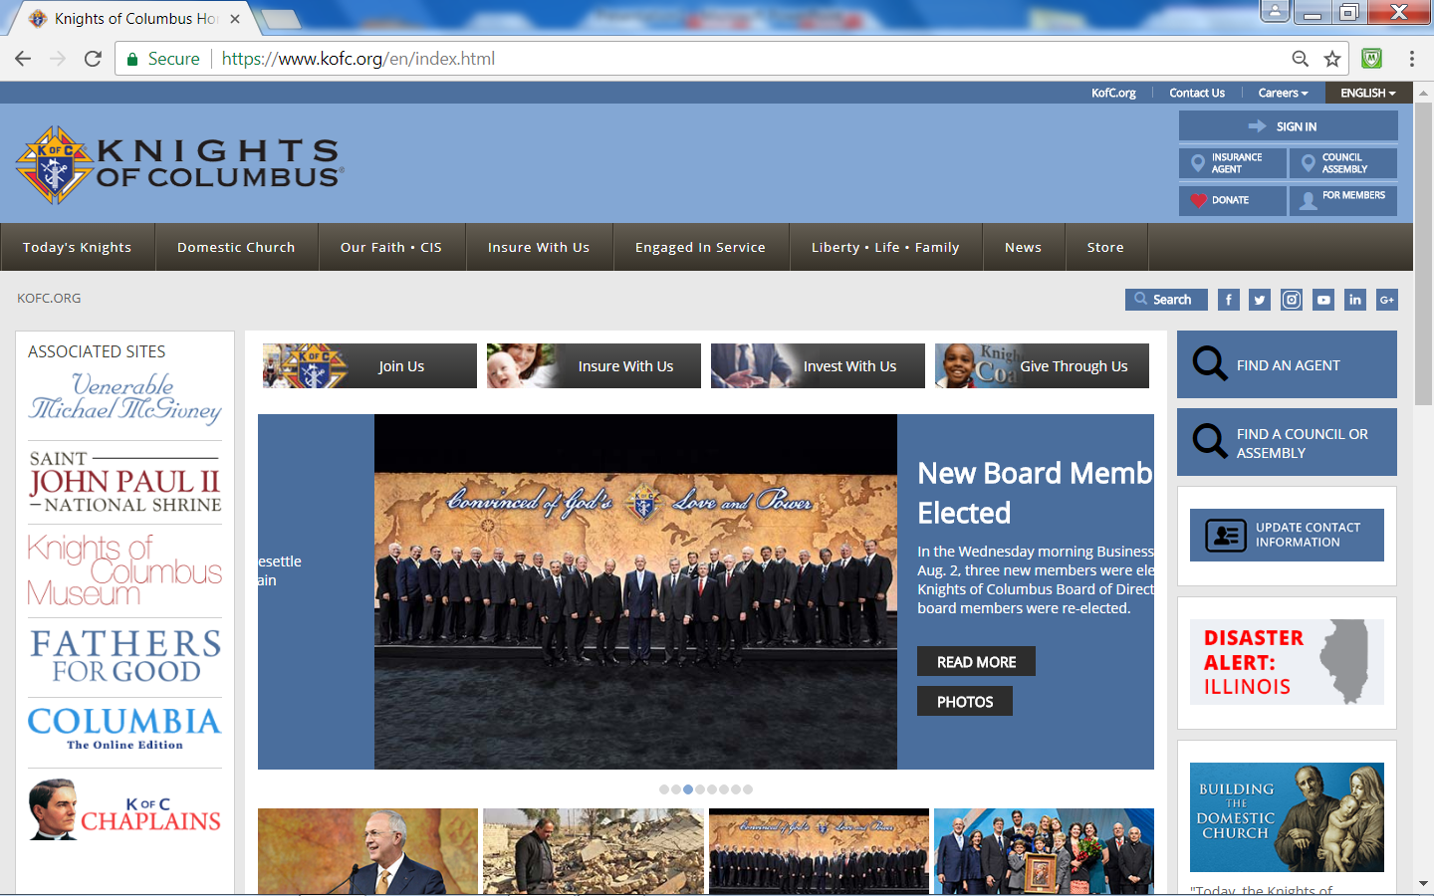
Supreme KofC Website
kofc.org

Slide 2
KofC Homepage
Click on Arrow to Select Preferred Language
Officers Online Sign In

Slide 3
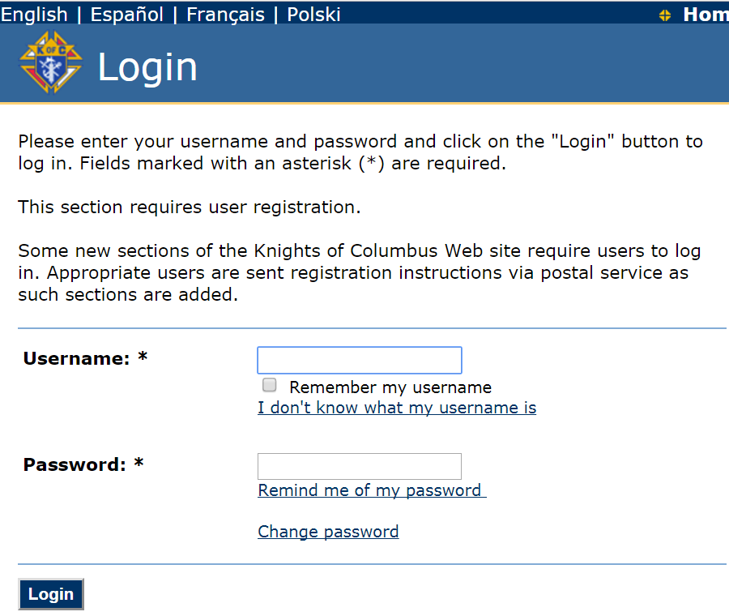
Log-in Webpage

Slide 4
Log-in Webpage
If Different Language is Desired, Click on Language of Preference

Slide 5
How To Change Webpage Language
To Instantly change the Language of "Most" web-pages:
1) Locate the two letters (en) in the website's address
2) Replace the two letters to:
- es for Spanish
- pl for Polish
- fr for French
- en to return to English
3) Hit Enter on your Keyboard
e.g. http://www.kofc.org/un/en/forms/council/101_p.pdf
e.g. http://www.kofc.org/un/es/forms/council/101_p.pdf
e.g. http://www.kofc.org/un/fr/forms/council/101_p.pdf

Slide 6
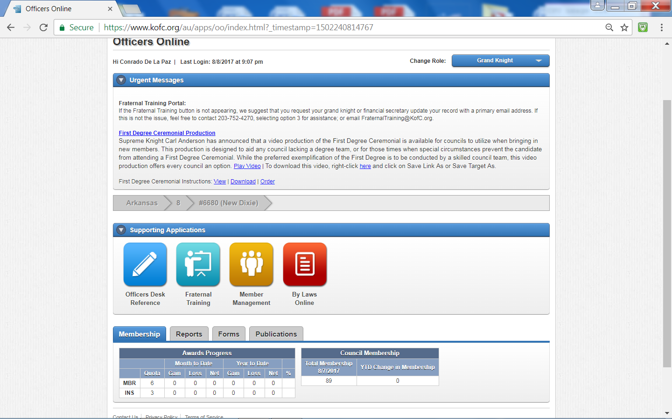
Officers Online Webpage

Slide 7
Officers Desk Reference
(ODR)
Provides guidance on the Interpretation of:
Constitution and Laws of the Order
Laws / Rules Governing 4th Degree
Governance of Councils and Assemblies
Guidance is "Binding" on:
Subordinate Units
Officers / Members

Slide 8
ODR
Is not Legal Advice which persons can rely for Securing Rights /
Remedies under Law of Jurisdiction
Does not create Affirmative Rights, Benefits, or Causes of Action
Substantive or Procedural, Enforceable at Law or in Equity
against:
Supreme Council
Subordinate Units
Officers / Members of Council
Unless stated, ODR does not impose Obligations/Liabilities on:
Supreme Council
Subordinate Units
Officers / Members of a Council

Slide 9
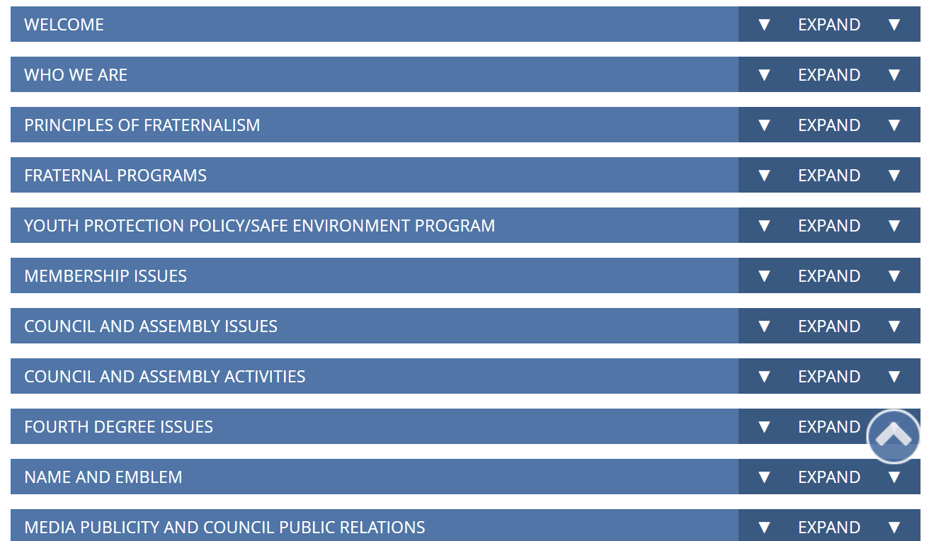
Subjects

Slide 10
Subjects (cont.)

Slide 11
Fraternal Training
Helps Leaders become "More Effective"

Slide 12
Fraternal Training
Council Officer Course
Enrollment Status
Where?
Right-side of Fraternal
Training page

Slide 13
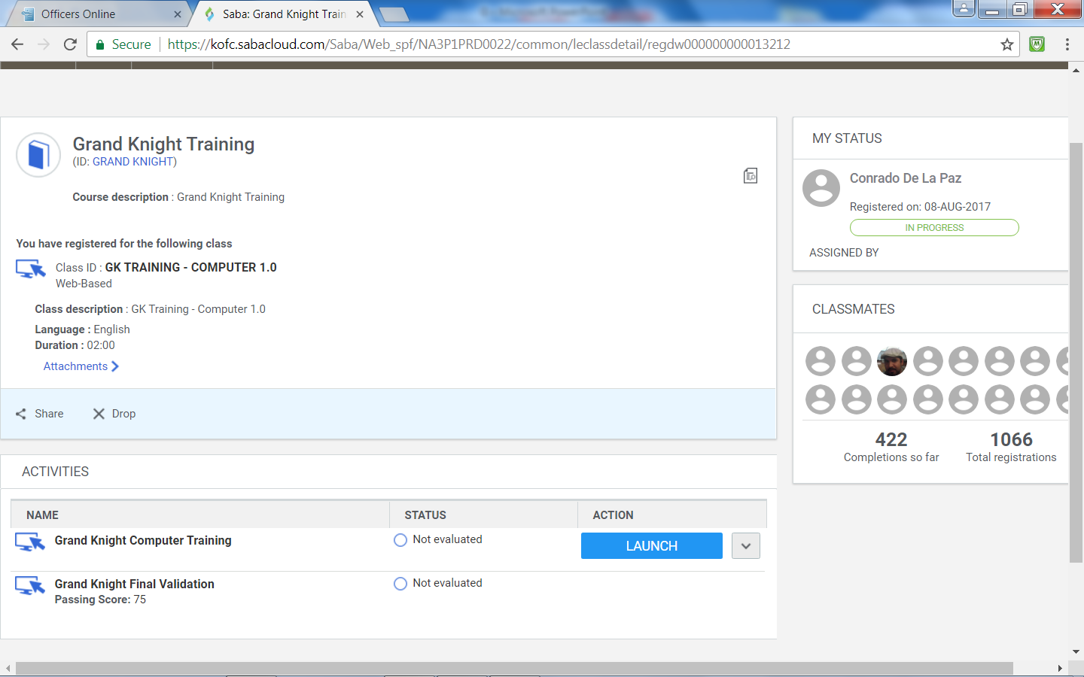
GK Training

Slide 14
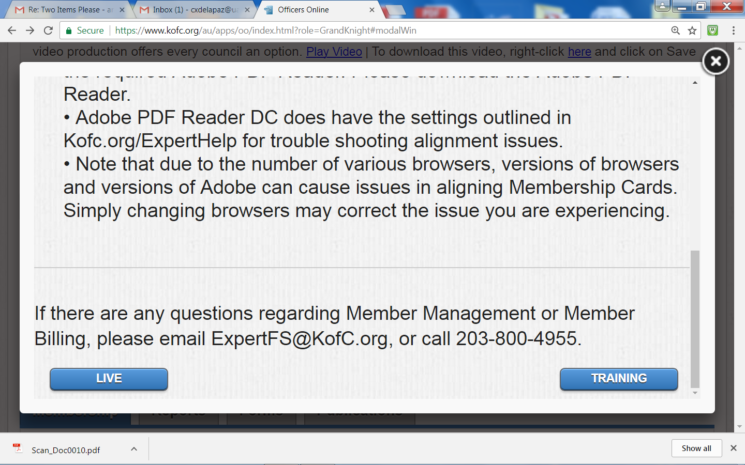
Member Management

Slide 15
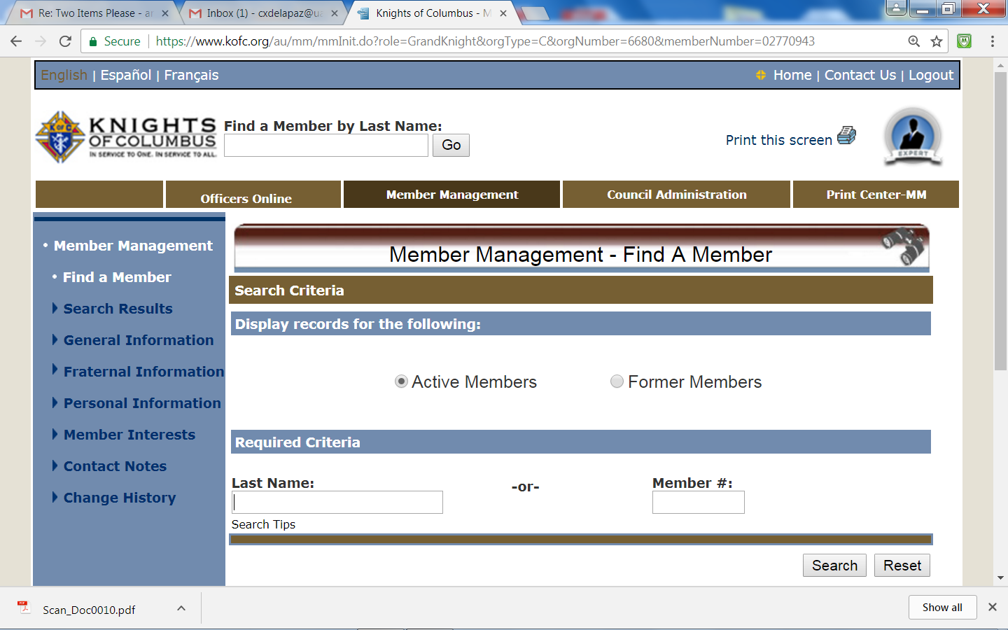
Member Management
Default Page

Slide 16
Example

Slide 17
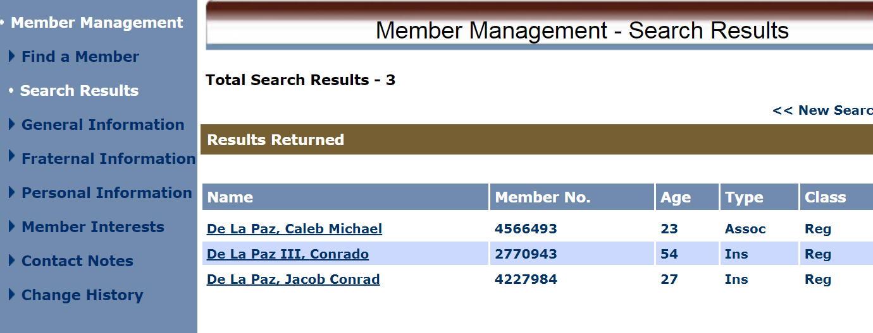
Example

Slide 18
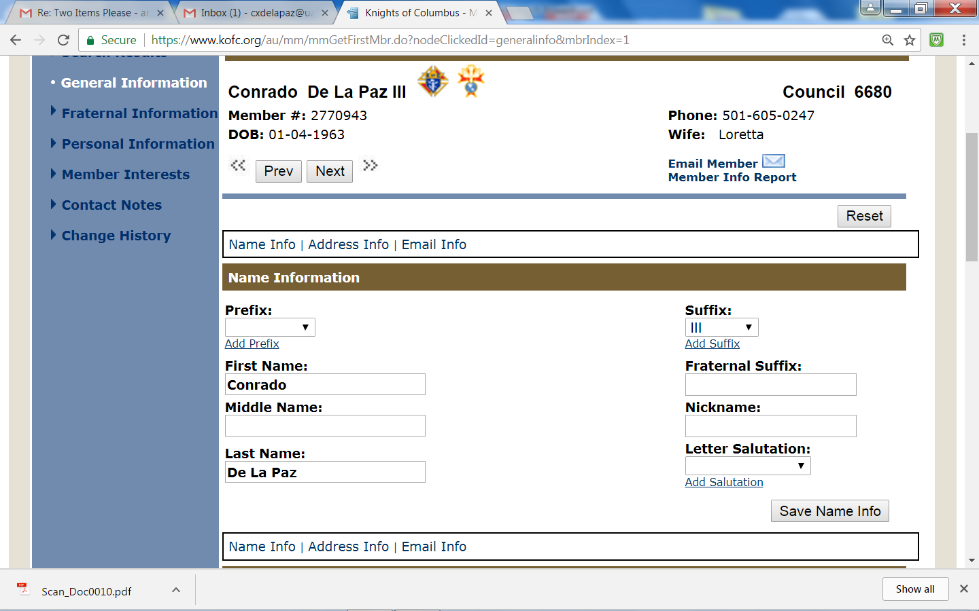
Example

Slide 19
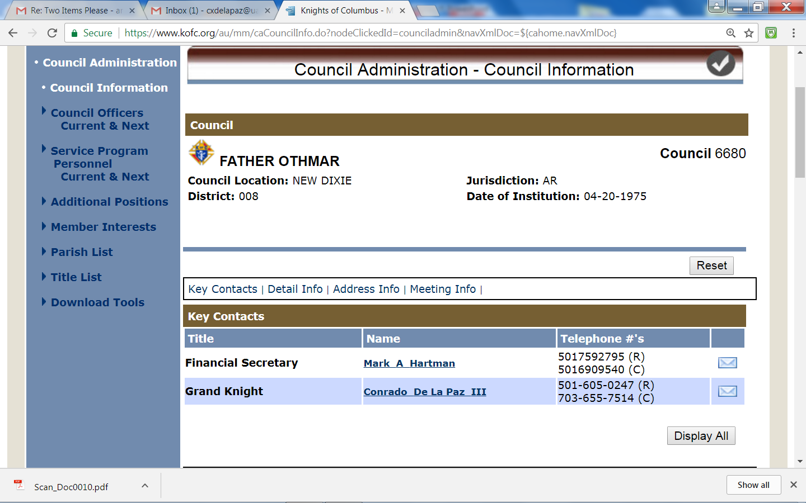
Council Administration

Slide 20
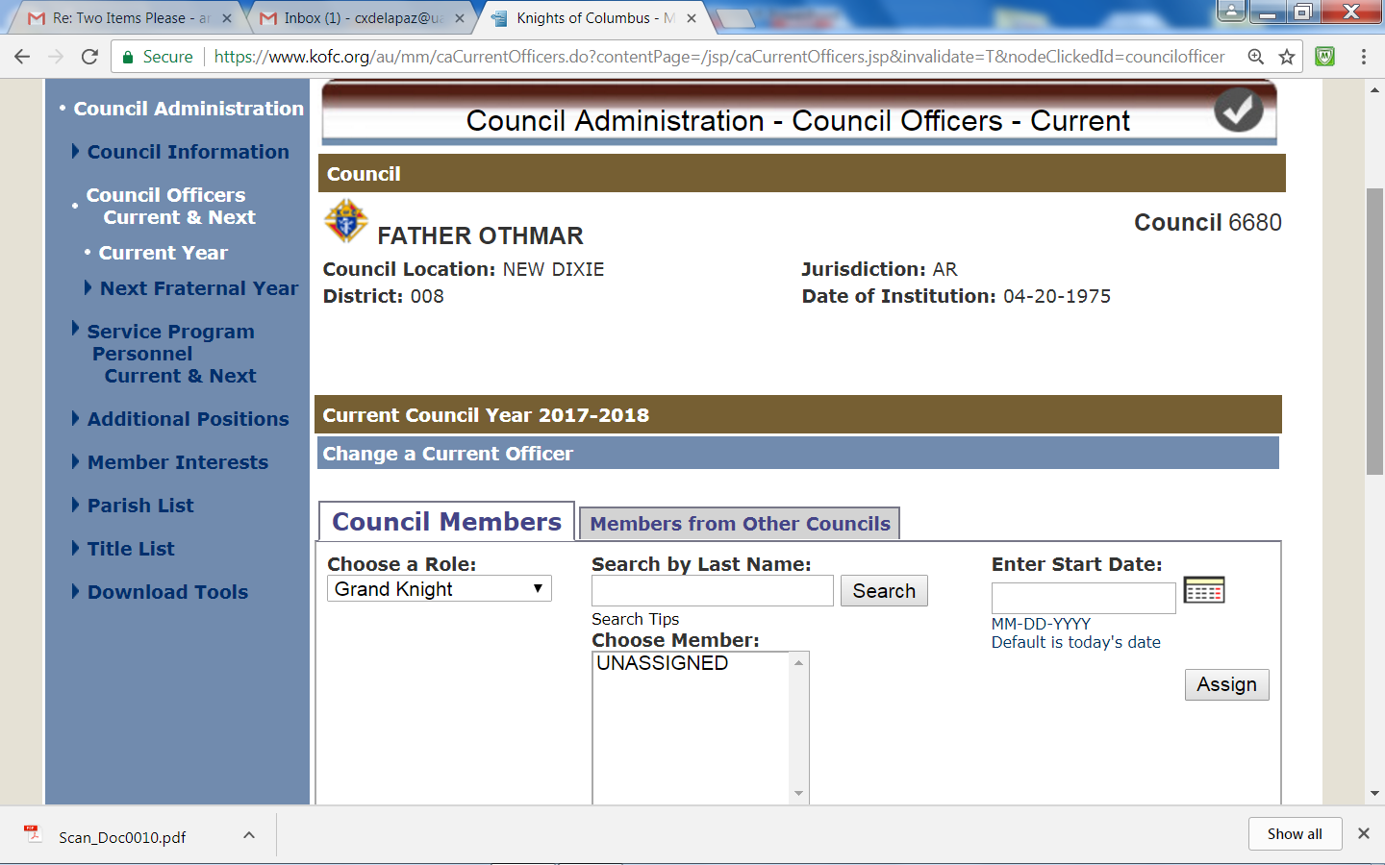
Council Administration

Slide 21
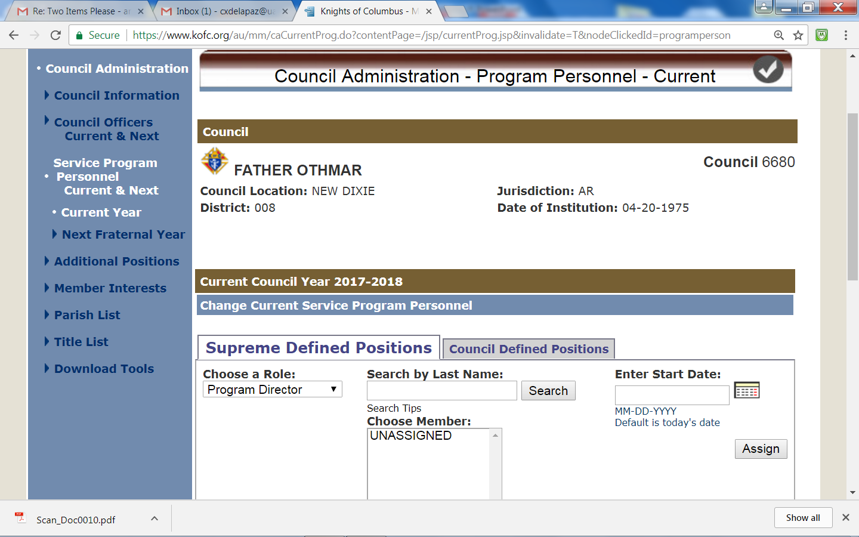
Council Administration

Slide 22
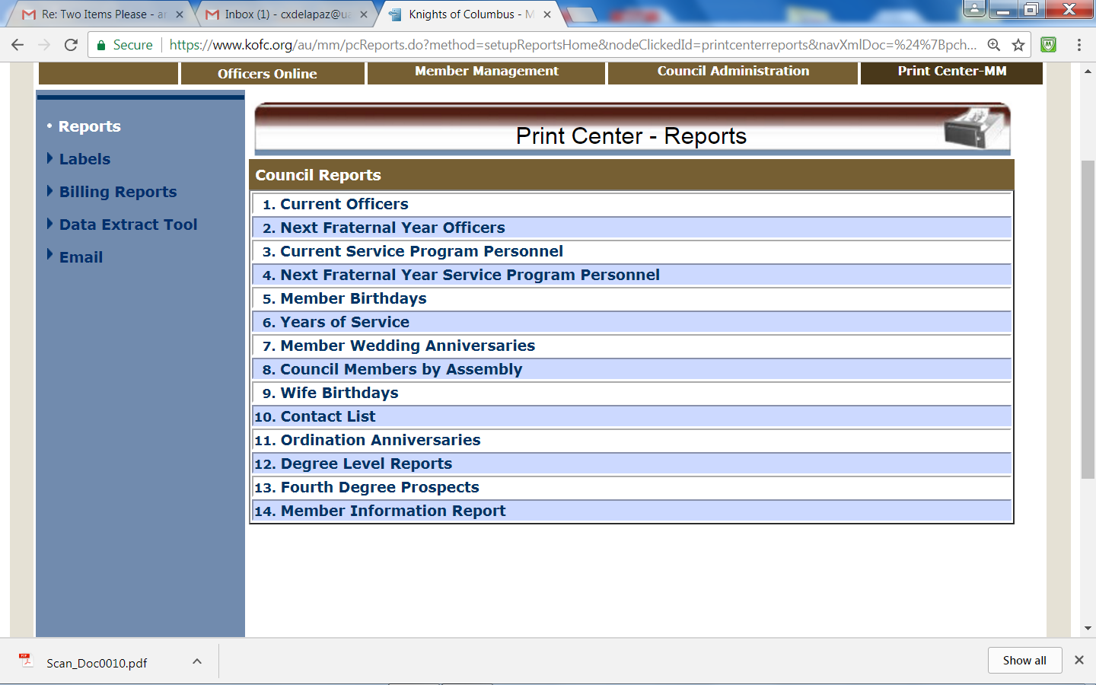
Print Center

Slide 23
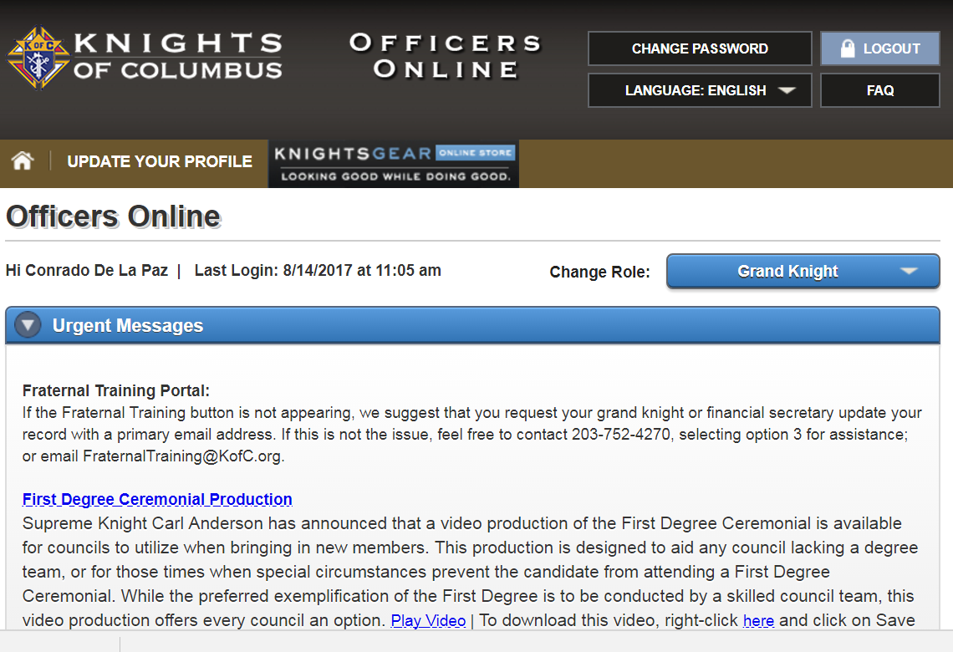
Officers Online

Slide 24
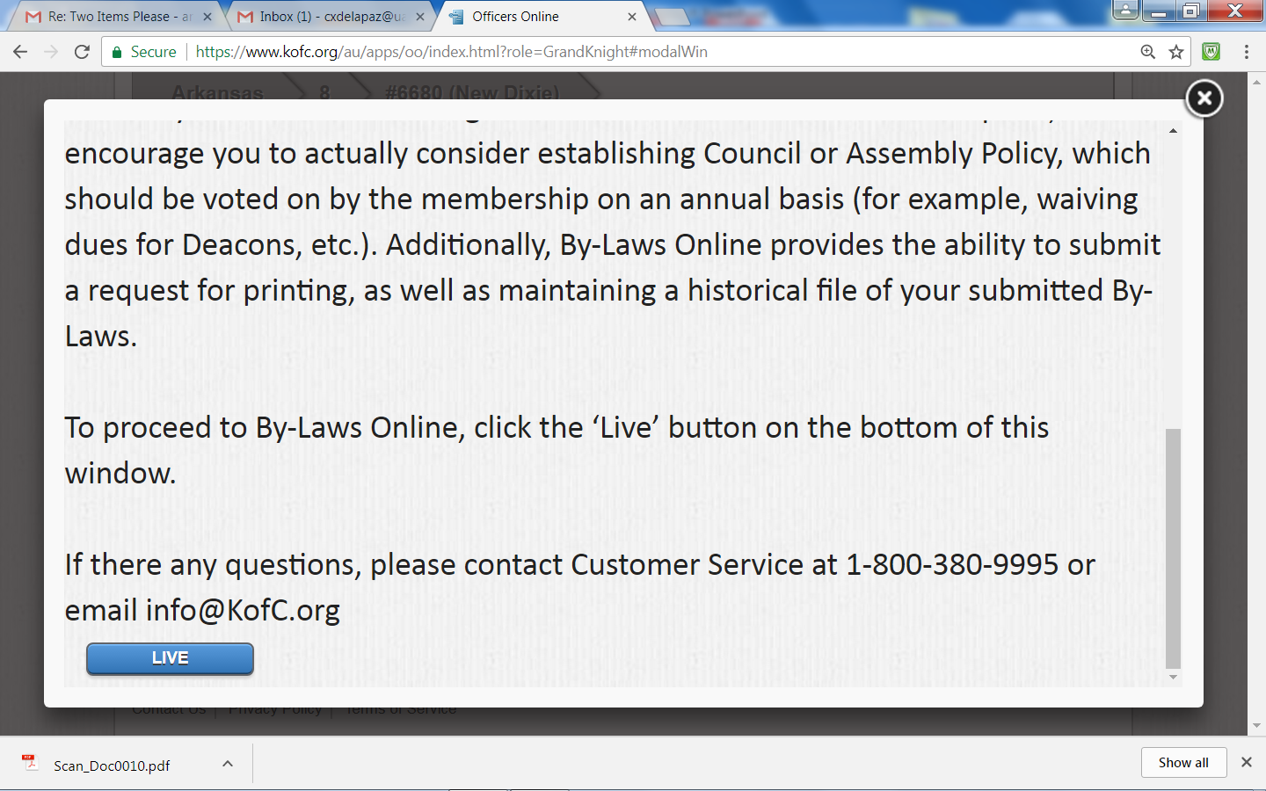
By-laws Online
Tool (site) to:
- Submit New or Revised By-Laws to the
Supreme Advocate for review / approval
- Submit request for Printing
- Maintain Historical file

Slide 25
Officers Online - Membership
Reflects:
- Council's Recruiting Goal / Progress during Fraternal Year
- Insurance Goal / Progress during Fraternal Year
- Council's Membership / Changes

Slide 26
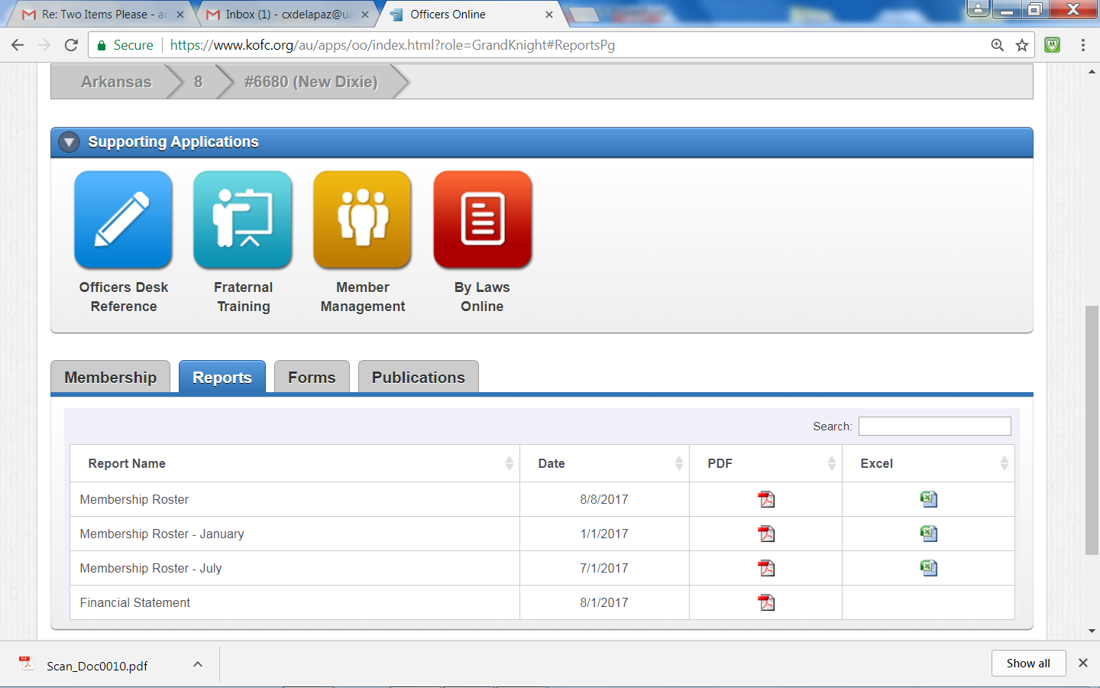
Officers Online - Reports

Slide 27
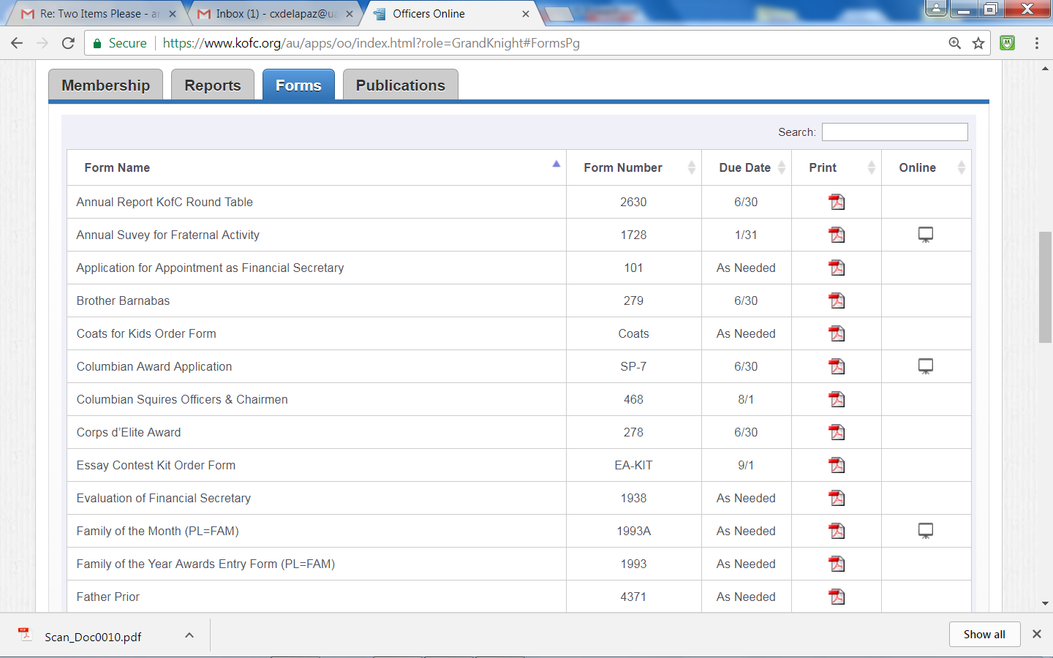
Officers Online - Forms
Indicates it can be completed Online

Slide 28
Officers Online - Publications
Displays:
- District Deputy Reports - 2012 till present
- Knightline - 2012 till present
- Leadership Handbooks
-- Chaplain’s Handbook -- District Deputy's Guide
-- Grand Knight's Guide -- Leadership Resources
-- Financial Secretary's Guide
-- Faithful Comptroller Handbook
-- Vocations Handbook

Slide 29
Resource Guides

Slide 30
GK's Guide
Provides overview of GK's Roles /
Responsibilities
Defines 10 keys to Success
Use in conjunction with:
- Knights of Columbus Leadership
Resources Handbook (#5093)
- Method of Conducting Council
Meetings Book (#10318)
#5085

Slide 31
10 Keys to Success
1. Strive to earn Star Council award
2. Be the "go to Charitable Organization" in your parish, community
3. Offer membership and its benefits to all eligible Catholic men
and conduct 1st Degree ceremonies on a frequent basis
4. Promote KofC Insurance
5. Set goals, Evaluate performance, and Plan for future
6. Enlist Pastor's support and Develop relationships with
community organizations
7. Share responsibilities
8. Use Council and Officer meetings to Brainstorm / Plan projects
9. Create atmosphere where all Members are Welcome and Valued
10. Communicate Regularly with Members

Slide 32
1st Key - Pursue Earning Star Council
Comprised of:
- Fr McGivney Award
- Founders' Award
- Columbian Award
To Earn you Must Submit:
- Service Program Personnel Report
(#365) due August 1st
- Annual Survey of Fraternal Activity
(#1728) Due January 31st
- Columbian Award Application (#SP7)
Due June 30th
- Remain in good standing with Supreme
Council Assessments
- *New! Ensure "Designated Members"
Complete Safe Environment Training
(In most cases GK and Youth Director)

Slide 33
Fr McGivney Award (Membership)
Growth = Membership Increases over Membership Losses
Losses that count against your Council's quota:
- Member Suspension or Withdrawal
"To Attain" Fr McGivney Award
- Recruit 7% of current Membership as of July 1st
or
- 4 New Members minimum (whichever greater)
- And Submit:
-- Service Program Personnel Report (#365) - 1 August
-- Annual Survey of Fraternal Activity (#1728) - January 31
- Remain in good standing with Supreme Council Assessments

Slide 34
Founders' Award (Insurance)
Quota is 2.5% Increase in Insurance membership
- Minimum is 3
- Maximum is 18
"To Attain" Founders' Award
- Meet Insurance Goal
- Submit:
1) Service Program Personnel Report (#365) - August 1
2) Annual Survey of Fraternal Activity (#1728) - January 31
- Remain in good standing with Supreme Council Assessments

Slide 35
Columbian Award
To Earn:
- Execute 4 activities/programs in each Surge with Service
Category (Church, Community, Council, Culture of Life, Family
Youth) OR one Featured Program
-- Four (4) Pgms Must be Designated Domestic Church Activities
e.g. - Renewal of Vows - Holy Family Prayer Pgm
- Food for Families - Refund Support Vocation Pgm - Journey to the lnn - 5th Sunday Rosary
- Submit:
1) Service Program Personnel Report (#365) - August 1
2) Annual Survey of Fraternal Activity (#1728) - January 31
3) Columbian Award Form SP-7
- Remain in good standing with Supreme Council Assessments

Slide 36
Columbian Award Entries

Slide 37
Columbian Award SP-7 Entries

Slide 38
Star Council
You also must Submit three (3) forms to Earn Star Council Award
1) Annual Survey of Fraternal Activity (#1728) - Due 31 Jan.
2) Service Program Personnel Report (#365) - Due 1 Aug.
3) Columbian Award Application (#SP7) - Due 30 Jun.
Submit forms:
- Electronically via Reports Online
or
- Download, complete manually and
-- Mail
-- Email
-- Fax

Slide 39
Forms
Contains Reports / Forms councils need
to submit during Fraternal Year
Forms arranged in Order of Deadline
Review monthly to ensure Council is
on Track
Keep a Copy of every Form Submitted
Forms also can be found at:
kofc.org/un/en/members/resources/forms/council.htmlkofc.org/form
#1436

Slide 40
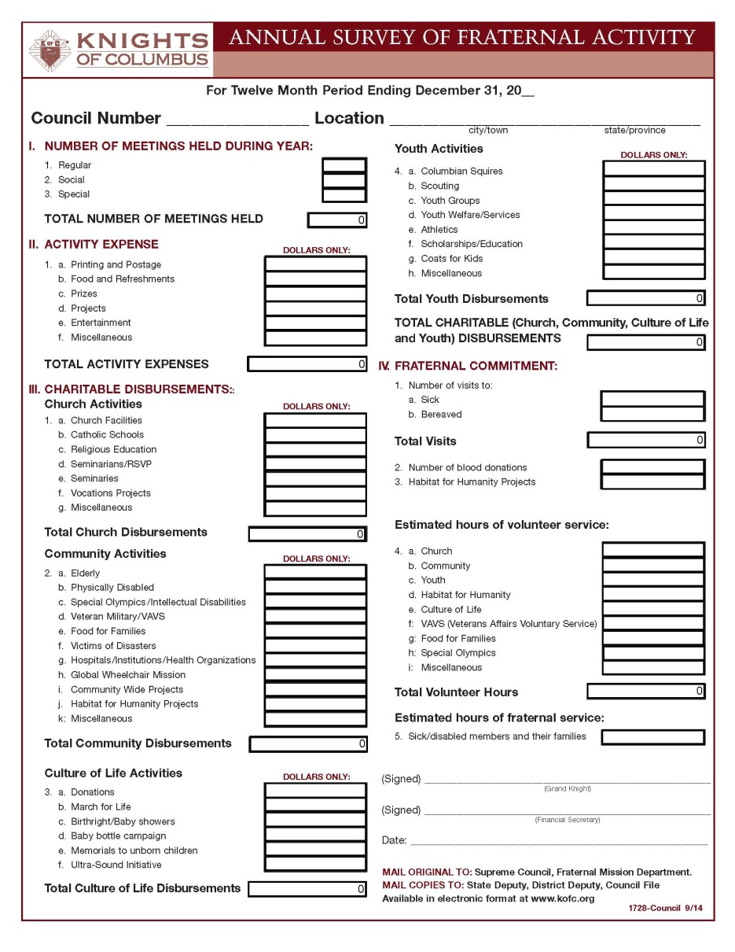
Annual Survey of Fraternal Activity
#1728

Slide 41
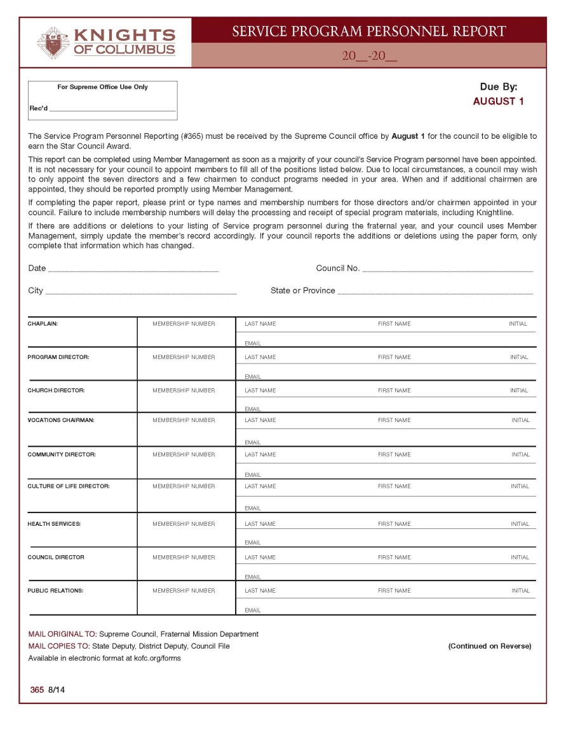
Survey Program Personnel Report
#365

Slide 42
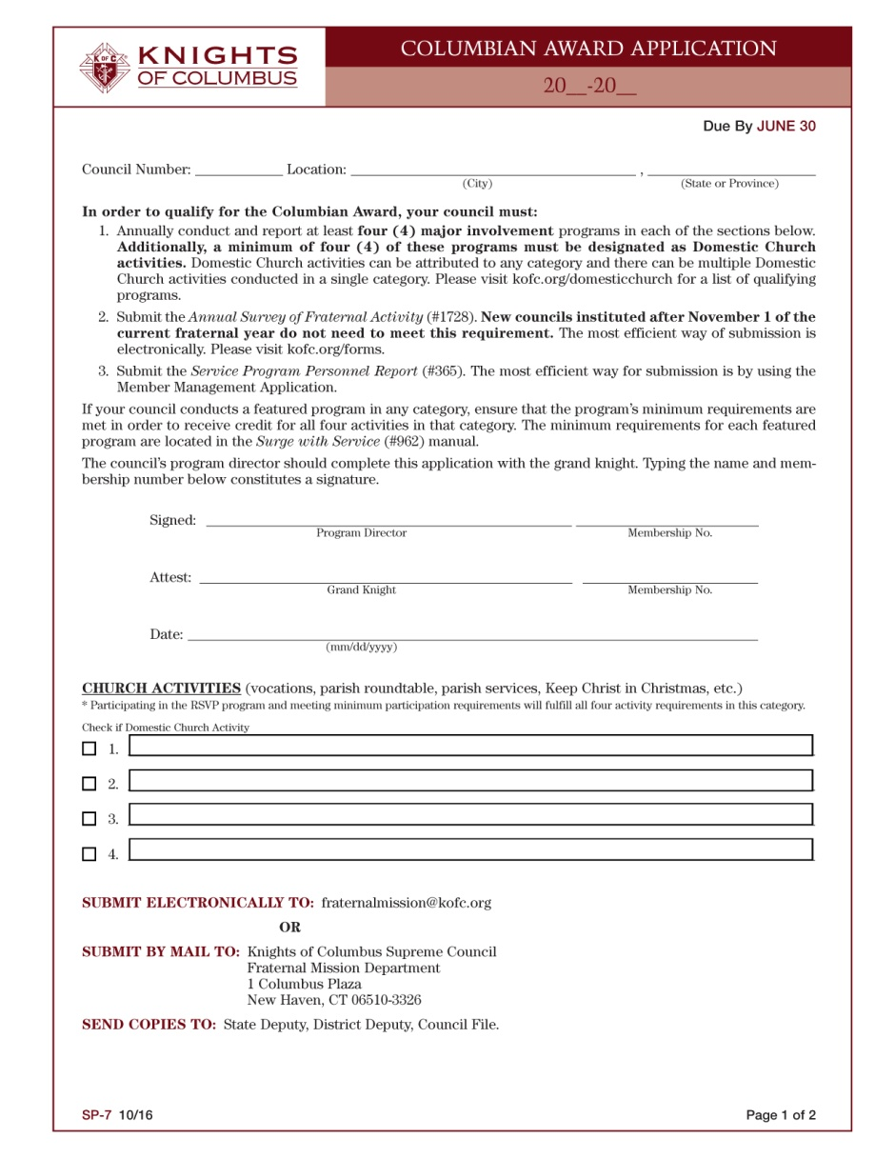
Columbian Award Application
SP-7

Slide 43
Safe Environment Training
Some KofC members are required to comply with KofC Safe
Environment Program
Certain members also must undergo "Background Check" every
two years
Members include:
- Grand Knight, training only
- Faithful Navigator - training only when Assembly sponsors a
Columbian Squire Circle
- Youth Director, training and Background Check
- Columbian Squires Chairman, training and Background Check
- Chief Counselor, training and Background Check
- Committee/Adult Counselors, training and Background Check

Slide 44
Safe Environment Training
Upon notification, Members must complete Safe Environment
Program Requirements within 30 days
- Members who do not comply within 45 days, are deemed ineligible
to serve in appointed position and will be automatically removed
- The GK will be advised of member’s ineligibility and will have option
to appoint a different member
Safe Environment Training consists of 3 training modules which
address “Best Practices” for Child Abuse Prevention / Detection
Paper and Pencil “Self-Study” Training Guides are available
Members who remain in Designated Positions must complete
training every 3 years

Slide 45
1st Key - Star Council
To Earn
- Set Goals
- Plan Early
- Involve Officers / Members
- Maintain Council's Focus

Slide 46
2nd Key - Be Go To Organization
Engage / Build Rapport with parish / community Leaders
Promote Charitable Events / Programs in Parish / Community (helps recruitment and retention)
Be Aware / Cognizant of charitable outreach opportunities and Most Importantly Engage!
Use Media to relate charitable programs / action stories
Advertise in Parish Bulletin, Local Paper
Engage Radio / Television to relate your council's charitable programs / stories
Distribute Flyers / council newsletters after Mass

Slide 47
3rd Key - Recruitment
Host:
- Church Recruitment Drive
- First / Admission Degree Ceremonies, Monthly
- Open Houses - Invite members and Potential Recruits
Utilize Field Agent
Ask Pastor to Endorse Letter of Invitation to Join Knights
Be Honest, welcoming and when appropriate, provide food
and Refreshments
Focus efforts on Eligible Catholic Men and engage their wife

Slide 48
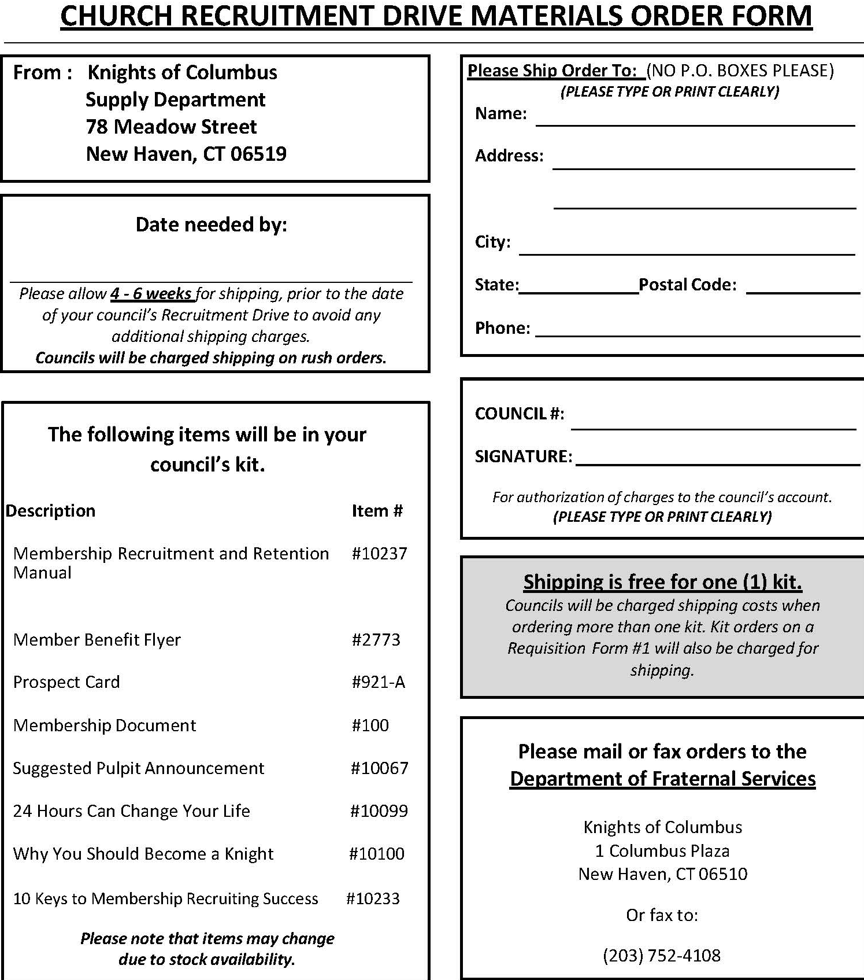
Church Recruitment Drive
https://www.kofc.org/en/resources/membership/driveform.pdf

Slide 49
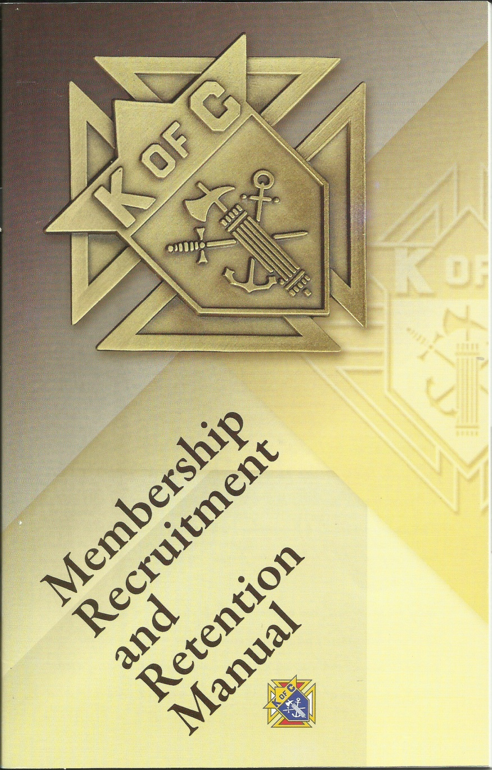
Recruiting and Retention
# 10237

Slide 50
Other Recruiting Tools
1. Father Wants You
2. Recruiting Team Multipliers
3. Snow Cone Drive
4. Agent All Out Blitz
5. Columbia Magazine
6. Recruiting during Mass - Prospect Cards

Slide 51
4th Key - Insurance
Insurance Promotion is Key Duty of GK
Why?
- Protection of Member's Family is key part of Founder's Vision
- KofC Insurance Offerings are among Highest in North America
Action:
- Utilize Field Agent to Assist in:
-- Promoting insurance to current Members
-- Heading Benefits Night to Promote and Educate
Members and Potential Recruits

Slide 52
5th Key - Set Goals
How?
- Host planning session to Set Goals and Plan Year's Activities
- Plan enough programs / activities to Earn Columbian Award
- Use Fraternal Leader Planner / Surge w/Service Kit to:
-- Set Goals
-- Evaluate Performance
-- Plan for Future
Questions to Ask:
- Is my council better than it was last month?
- What can we do to help more people?
- How can we do better?
Don't get stuck in a Rut / Be open to Change!

Slide 53
6th Key - Enlisting Support
Engage your Pastor, Parish Pastoral Team, District Deputy,
General / Field Agent and Key Community Leaders
Develop Working Relationships with Local Organizations to:
- Boost membership
- Ensure charitable service program success
- Plan year's activities
Solicit your council's input to identify alliances / partners that
would further your charitable mission
Engage Catholic Leaders from:
- Hospitals
- Catholic Schools
- Seminary
- Catholic Agencies

Slide 54
7th Key - Delegate
Delegation is Essential to Effective Leadership
Prior to Delegating a Task
- Define / Articulate Requirement
- Discuss and Define Course of Action
Once a Task is Delegated, let go......BUT
- Check on progress
- Communicate often till Complete

Slide 55
8th Key - Meetings
KofC Meetings should be Productive
Schedule / Conduct Officer's meeting to:
- Prepare Agenda for Council Meeting
- Conduct In-depth planning
- Brainstorm
Council Meetings:
- Organized
- Engage Members / Officers in Programs
- Provide Spiritual and Educational Component
- Forum to transact council Business
- Provide Information on upcoming Events

Slide 56
8th Key - Meetings
Council Meeting are Not:
- Time / Place to recruit workers for programs
- Place to start the planning process
- Open forum to debate the details of an event
- A social gab-fest
Meeting Resources Include:
- Method of Conducting Council Meeting #1937
- Protocol Handbook #1612
- Surge with Service CD Kit
- Roberts Rules of Order at:
robertsrules.com or rulesonline.com

Slide 57
9th Key - Value Your Members
Build Team Atmosphere
Be open to Change
Identify and Utilize members' Talents
Communicate, especially details
Listen and Weigh opinions of fellow Officers, Directors,
Committee Chairman, Brother Knights
Seek ways to Engage and Communicate with each group
In difficult situations, seek Advice of Chaplain, District Deputy,
former GK's and DDs
Weigh and utilize Opinions to render Decisions
Recognize Accomplishments, Birthdays, death of their family
members
Bottom line: Don't let your Ears Slam Shut - Listen for Meaning

Slide 58
10th Key - Communications
Communicate Regularly with Members
Write monthly column / publish monthly newsletter
Use Parish bulleting and local media
Utilize Parish marquee
Establish and Communicate Goals / Priorities by:
- Planning Calendar of Events immediately after Election
- Hold Installation of Officers as close to 1 July as possible
- Proceed Officer Installation Ceremony with Social to
convey and promote Goals / Priorities

Slide 59
Leadership Resources
Provides Information on Conducting
Charitable Activities and Increasing
Membership
Details Duties of District Deputy,
Grand Knight, Financial Secretary
Addresses / Provides:
- Organizational Chart
- Supreme Directory
- Forms, Reports
- Qualifications for Membership
- Initiation Fees / Council Dues
- Awards
- Opening / Closing Odes
- Overview of Officer Duties
#5093

Slide 60
Method of Conducting Council Meetings
Addresses:
- Chamber setup
- GK Responsibilities
-- Duties and Ceremonials
- Guidelines for Conducting:
-- Officers’ meeting
-- Council meeting
- Parliamentary Procedures, Motions,
Terms, Voting
- Officer Elections
- Reports
- Committees
#10318

Slide 61
Method of Conducting Council Meetings
Responsibilities of Grand Knight "Ceremonials":
- Ceremonials
- Coordinates Installation of Council Officers with District Deputy
- Schedules and publicizes monthly Admission Degree
- Confers with District Deputy for Formation Degree and
Knighthood Degree
- Arranges Mass for departed brothers
- Awards certificates, cards, and pins during Honorary / Honorary
Life Ceremonials
- Maintains "Proper" Conduct at Meetings and Ceremonials e.g.
Admission Degree, Honorary or Honorary Life Ceremonial

Slide 62
Method of Conducting Council Meetings
Responsibilities of Grand Knight "Duties":
- Appoints Council’s Chaplain, Membership Director
Program Director, Members to Standing Committees
(Admission, Recruitment, Retention
- Schedules / Presides council Officer Meetings
- Appoints members to serve on Admission Committee and
ensures its Functionality
- Monitors Progress toward earning Star Council
- Recognizes Honorary / Honorary Life members , Past Grand
Knights, Knight of the Month / Year, Community Leaders, etc
- Conducts Semiannual Council Audit Report with Trustees

Slide 63
Method of Conducting Council Meetings
Responsibilities of Grand Knight "Duties":
- Ensures that Council Forms and Reports completed /
submitted to Supreme
- Establishes a council Admission Degree Team
- Arranges for council representation at Wakes / Memorial
Services for Deceased Brothers
- Arranges for the Resolution of Condolence (#1450) to be
presented to Family
- Oversees that Council Reports from Officers / Committees are
Recorded in council's files
- Starts council Meetings on time and ensures they are
conducted in Timely and Efficient manner

Slide 64
Method of Conducting Council Meetings
Step-by-step Guidelines to Conducting:
- Officers’ Meeting
- Council Meeting

Slide 65
Officers' Duties, Responsibilities
Details meaning of Order's Emblems
Provides explanation of your Jewels
of Office
Lists Duties and Responsibilities of
Council Officers and Directors
#4241

Slide 66
Protocol
A "System of Rules" that Explain the Correct Conduct and Procedures to be followed in Formal Situations
Addresses anything that is Proper and in Good Taste
It's Impossible to Cite every Rule Governing all Situations; however apply "Formal Courtesy" and you won't go wrong in situations not addressed in KofC Protocol Booklet #1612
Unwritten Rules to follow:
- "Always" display Proper Consideration for Office Held and/or
Represented by person
- Do not let "Dislike for a person" Influence your Respect for
the Office he holds / represents

Slide 67
Protocol Handbook
Addresses Protocol for:
- Meetings (council / assembly)
- Chamber setup (council / assembly)
- Dress for meetings
- Correspondence, Invitations
- Dignitary Visits
- Head Table, Procession
- Flags, Jewels
#1612

Slide 68
Guidance Resource
Using it will:
- Help you make good Use of your time
- Focus Actions / Programs/ Activities
- Plan for Future (set goals)
- Keep on track with Order's Mission via
Program Spotlight
- Determine council Needs and Prioritize
- Track council activities / progress
- Measure Success
- Evaluate Performance
- Determine Changes for Success
- Identify opportunities to integrate
membership, programming and
charitable activities
#5033

Slide 69
Surge with Service
kofc.org/surge website
Plan / Implement Service Programs
Help your Parish / Community
Work as a Team

Slide 70
Surge.....With Service
Provides:
- Information to Plan / Implement
Service Programs
- Programs that Facilitate team-work and
Build bonds of Friendship / Fraternity
Describes programs in the Church, Council,
Community, Culture of Life, Family and Youth
categories
Addresses:
- Star Council
- Council Budgets
- International Service Awards
Well-run Programs assist the Needy while
Strengthening the Bonds that unite Members
#962

Slide 71
Surge.....With Service
http://kofc.org/un/en/members/programs/council-activities/surge-kit.html
Provides links to:
Surge...with Service program manual (#962)
Grand Knight's Guide (#5085)
Method of Conducting Council Meetings (#10318)
Supply Catalog (#1264)
Charter, Constitution, Laws of the Knights of Columbus (#30)
Council Report Forms Booklet (#1436)
Knights of Columbus Protocol Booklet (#1612)
Family of the Month booklet (#1993).
Duties / Responsibilities of Council Officers / Directors (#4241)
Knights of Columbus Round Table Program booklet (#2632)
Knights of Columbus Certificates flyer (#2640)

Slide 72
Surge.....With Service
http://kofc.org/un/en/members/programs/council-activities/surge-kit.html
Provides links to:
Vocations Handbook (#1942)
Getting Your Message Across - KofC Councils Public Relations
and Publicity Guide (#2235)
Knights of Columbus Substance Abuse Awareness Poster Contest
Substance Abuse Awareness Poster Contest Guide (#4112)
“Your Story in Columbia” flyer (#4344)
Parish Round Table Initiative flyer (#4519)
Soccer Challenge Guide (#4576)
Youth Protection Program booklet (#4670)
Financial Secretary Quick Facts flyer (#4720)

Slide 73
Surge.....With Service
http://kofc.org/un/en/members/programs/council-activities/surge-kit.html
Provides links to:
Chaplain's Handbook (#945)
CIS program
Financial Aid booklet (#951)
Free Throw Guide (#1928)
Father Michael J. McGivney Guild
“Promoting the Insurance Program” flyer (#4532)
Catholic Citizenship Essay Contest (#4202)
Membership Recruitment and Retention Manual (#10237)
Knights of Columbus Leadership Resources (#5093)
Financial Secretary's Guide (#5089)
Safe Environment Manual (#5095)
Fraternal Leader Success Planner (#5033)

Slide 74
Installation of Council Officers
District Deputies' Most Important Obligation!
Why? It positions him as guide, friend, and mentor to his assigned councils.
Guide found on Knights Gear website, Only
Guides Provides:
- Officers Diagram Chart (cross)
- Installation ceremony
Officers eligible to Preside over Ceremony:
- District Deputy, Warden
- State Deputy
- Past District Deputies, Past State Deputies
# 770

Slide 75
Resources - Chaplain's Handbook
Provides:
- History of Fr McGivney
- Organization Chart
Describes Relationship of Chaplain to the Council
Details:
- Appointment of Chaplain
- Nature of our Order
- Role of Chaplain in working with
council
#945

Slide 76
Certificates
Contains 3rd Degree Certificates available from Supreme
Unique way to honoring Outstanding Accomplishments of Deserving Members and their Families
Brother Knights deserve to be recognized for their Contributions
Order from Supply Department, Fraternal Services or Ceremonials Dept.
#2640

Slide 77
Supply Catalog
Format designed to help Quickly Locate Materials
Materials can be ordered via Requisition Form (#1)
#1264

Slide 78
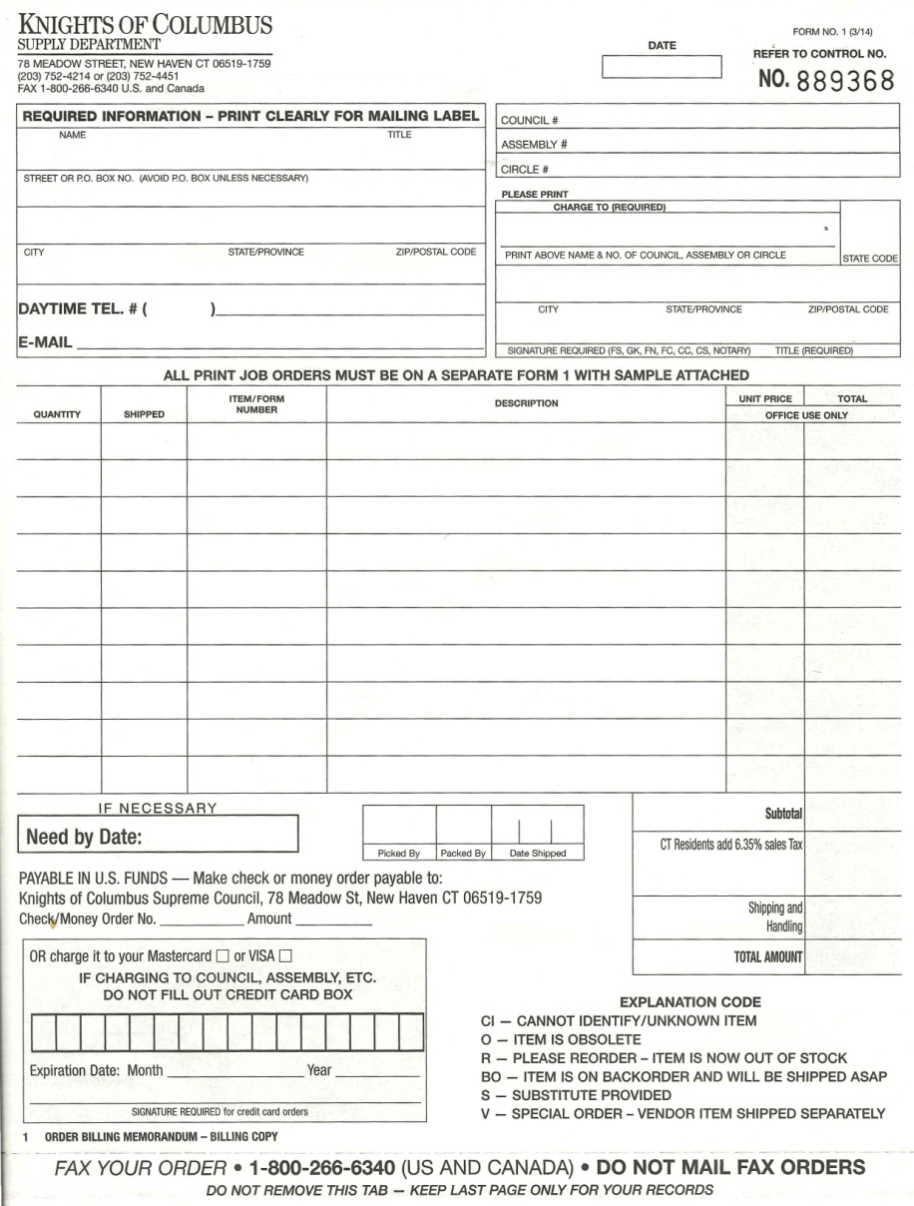
Supply Requisition Form #1

Slide 79
Per Capita - State
State "Per Capita" must be paid to State Secretary before State Convention
- Convention always held last weekend in April
- $10 per member
-- Amount based on Membership as 1 January
-- Honorary Life Members / Disabled Members not charged

Slide 80
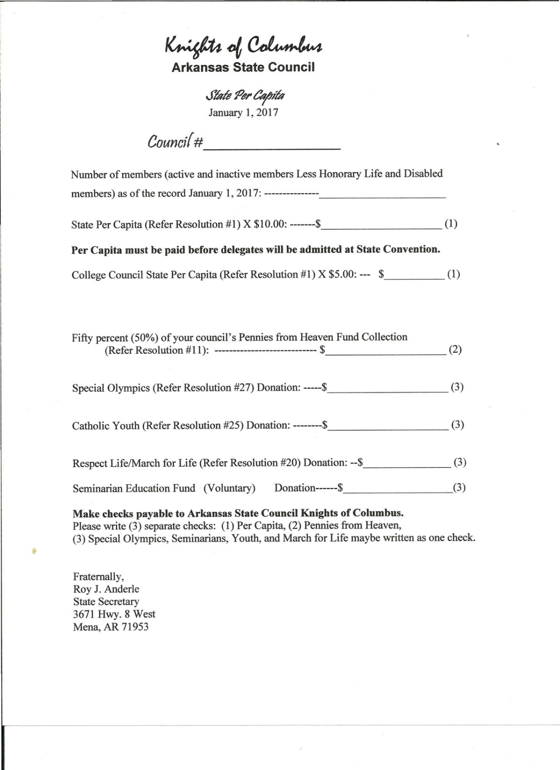
Per Capita Form - State
Number of Members
Per Capita X $10.00 per member (Resolution #1)
College Council State Per Capita X $5.00 (Resolution #11)
Fifty 50% of your Council's Pennies from
Heaven Collection Fund (Resolution #11)
Special Olympics (Donation)
Catholic Youth (Donation)
Respect Life/March for Life (Donation)
Seminarian Education Fund (Donation)

Slide 81
Per Capita - Supreme
Supreme "Per Capita" is paid twice a year (due by 15 Feb and 15 Aug)
- $ 1.75 per member (amount billed twice a year)
- $ 1.00 per member for Culture of Life
- $ 0.50 cents per member for Catholic Advertising
Councils not billed for Honorary Life Members and
Disabled Members

Slide 82
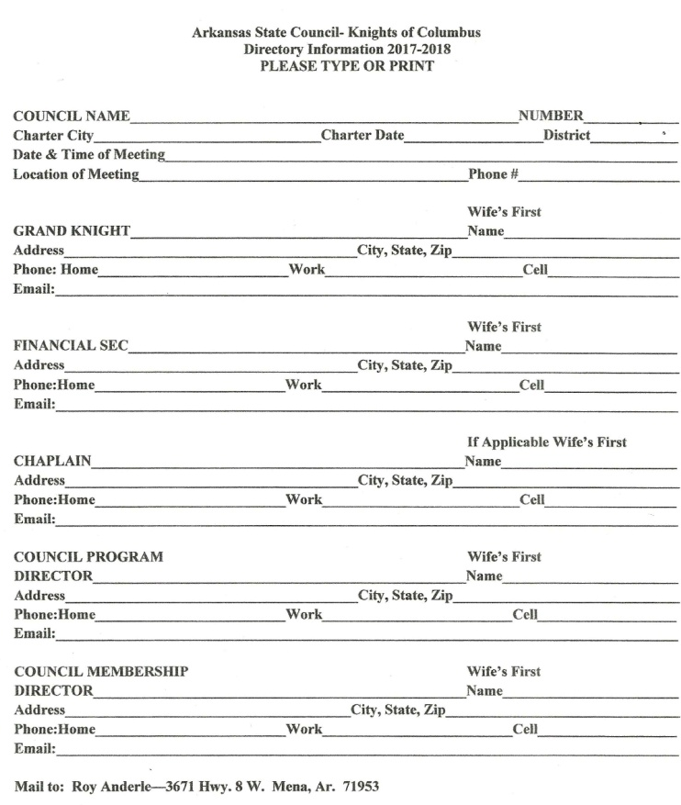
State Directory Form
Due: Day after Election of Council Officers,
but NLT 20 June
Information Required:
- Council
-- Council Name, Number, Charter City,
Charter Date, District, Meeting Date,
Time and Location, Phone #
- Grand Knight, Financial Secretary,
Chaplain, Council Program Director,
Council Membership Director
-- Name, Wife's First name, Address,
City, State, Zip, Home Phone, Work
Phone, Cell Phone, Email Address
Mail / Email to:
State Secretary
Roy Anderle
3671 Hwy 8 W, Mena, AR 71953

Slide 83
Exemplifications
Point of Contacts:
- Admissions (First) Degree: Grand Knight
- Formation (Second) Knighthood (Third): Ceremonials
Director Benjamin Frizzell
- Patriotic (Fourth) Degree: District Master Newton
White
POC email addresses:
- benjamin.frizzell@gmail.com
- nwhite@isiequip.com
Note: All Admissions (First) Degree Exemplifications should be held in Honor of Blessed Fr. Stanley Rother

Slide 84
Exemplifications
Keep District Deputy and Field Agent apprised of all Admission (First) Degree Exemplifications
Form 100s must be signed by council Grand Knight and Financial Secretary
Ensure Financial Secretary submits Form 100 to Membership@KofC.org after Admission (First) Degree Exemplification

Slide 85
Exemplifications
Keep District Deputy / Field Agent apprised when coordinating / scheduling:
- Formation (Second), Knighthood (Third) Exemplifications
- Patriotic (Fourth) Degree Exemplifications
Ensure District Deputy accomplishes Degree Exemplification Report - Form 450
Next 2nd / 3rd Degree Exemplifications:
- 17 Sep: Little Rock, Christ the King, Registration - Noon
- 15 Oct: Altus, St Mary's, Registration - Noon
Next 4th Degree Exemplification:
- 14 Oct: Little Rock, Christ the King, Registration - 12:30pm

Slide 86
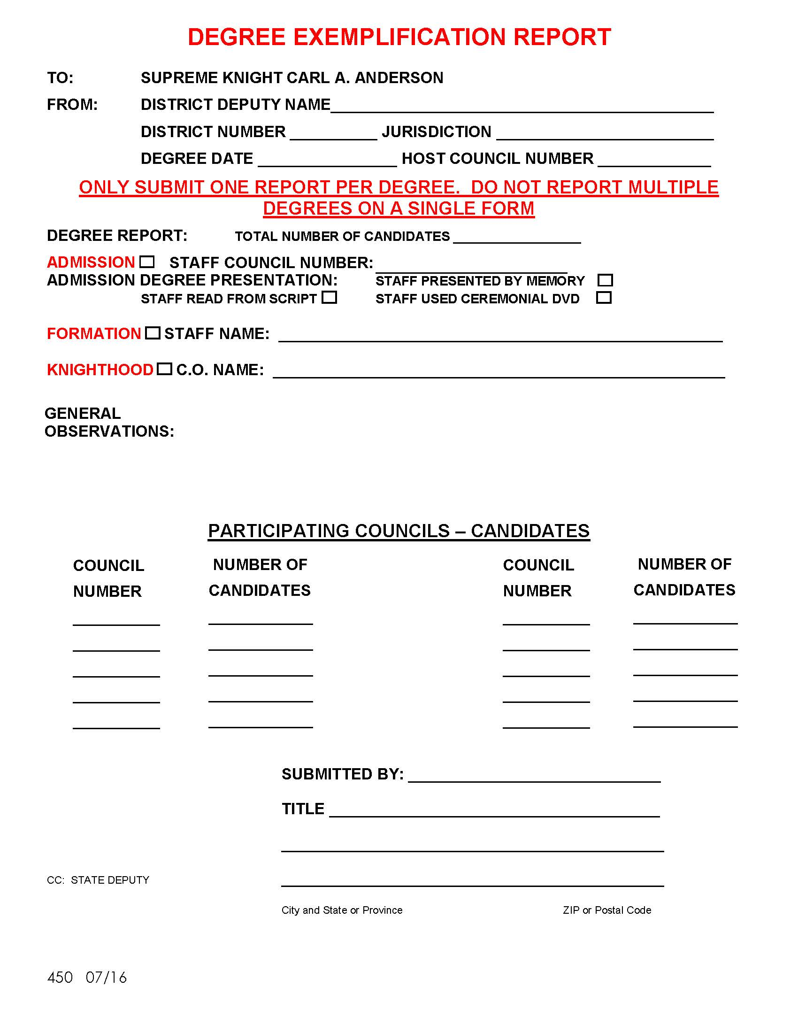
Degree Exemplification Report
Form 450
Email to: ceremonials@kofc.org

Slide 87
Admission (First Degree) Video
Admissions (First) Degree video
- View from Officer's Online
- Download from Officer's Online
or
- Order Video from Officer's Online
For Written Transcript / materials
- Email: ceremonials@kofc.org

Slide 88
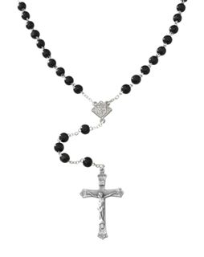
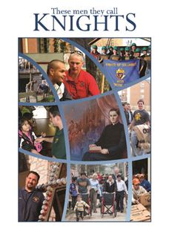
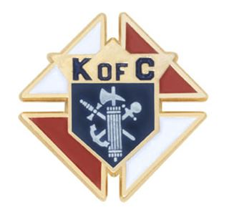
Exemplifications
Don't Forget!
937
When utilizing Video for 1st Degree Exemplification,
use Props, e.g. Compass, during ceremony

Slide 89
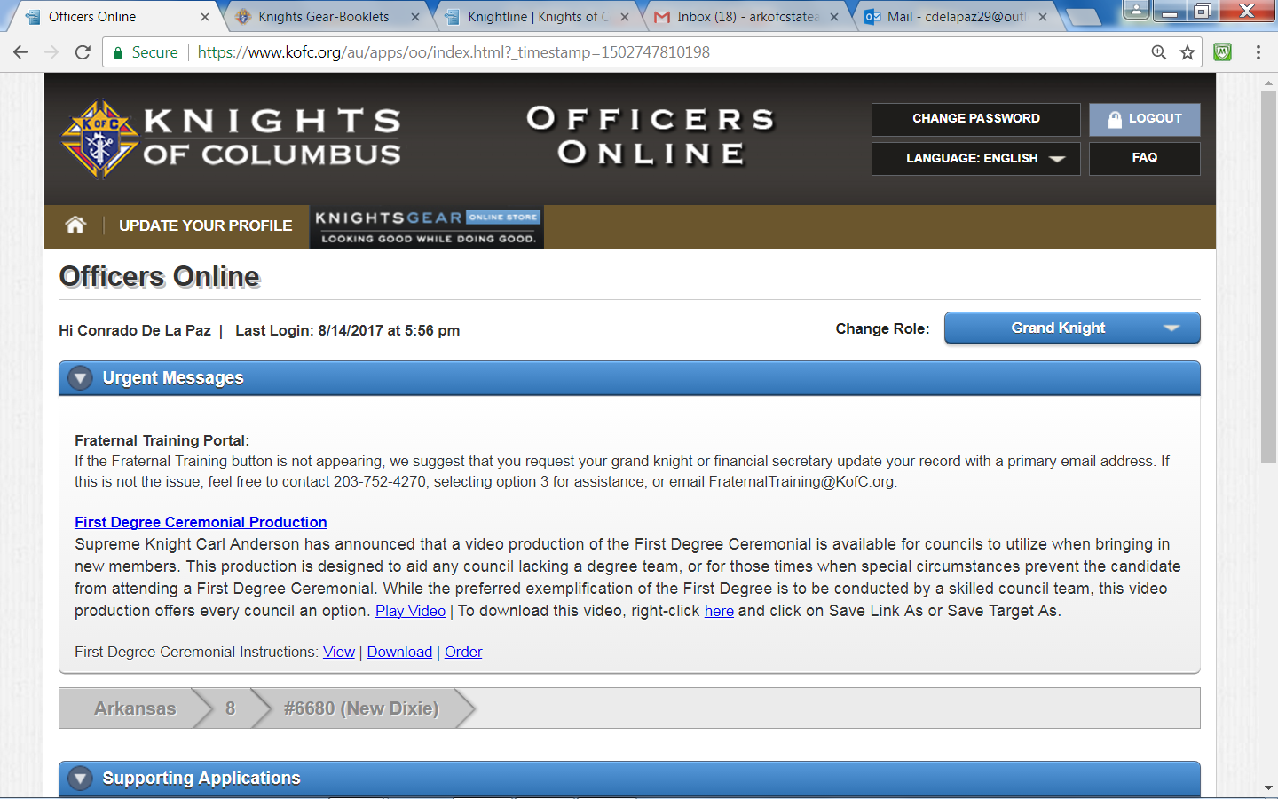
Knights Gear
kofc.org

Slide 90
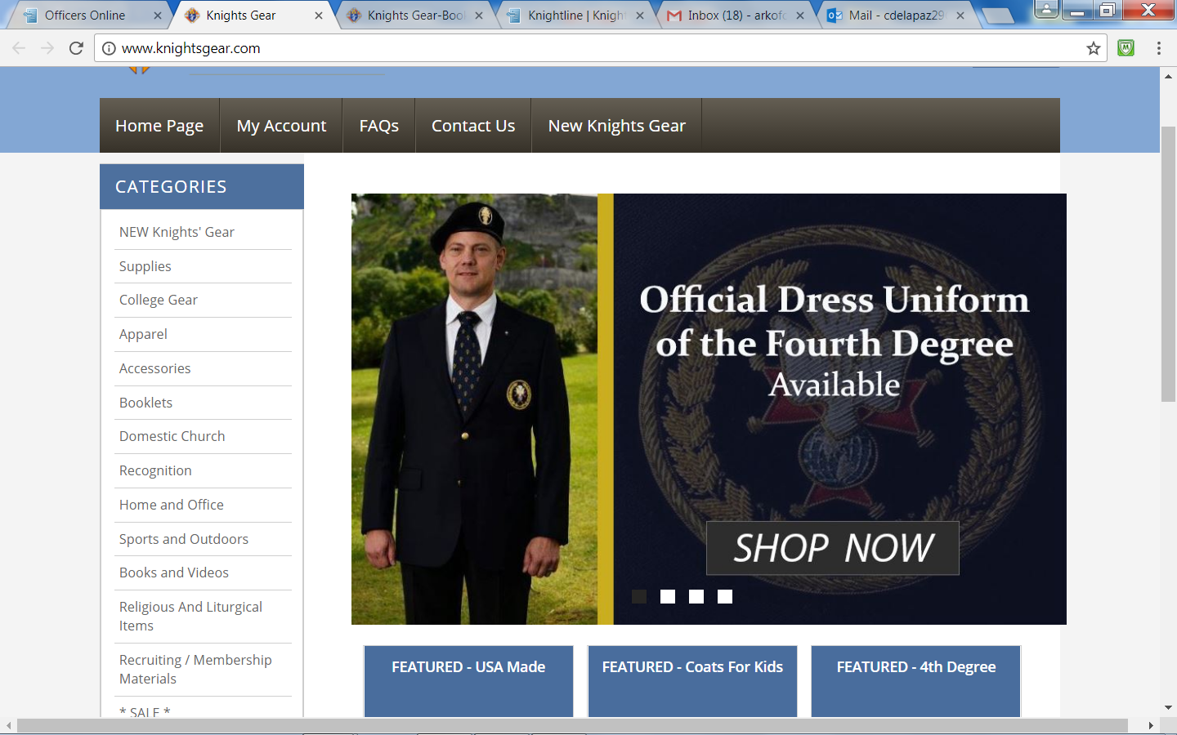
Knights Gear
Recommend Using Search Feature

Slide 91
Knights Gear
Most Printed Materials can be ordered in English,
Spanish, and French
Most KofC Forms and Pamphlets are Free or low cost
At Checkout: Ensure to select your desired mode
of Shipment - Default is not least expensive!
Recommend Using Search Feature
Hint! Field Agents can get forms at No Charge!

Slide 92
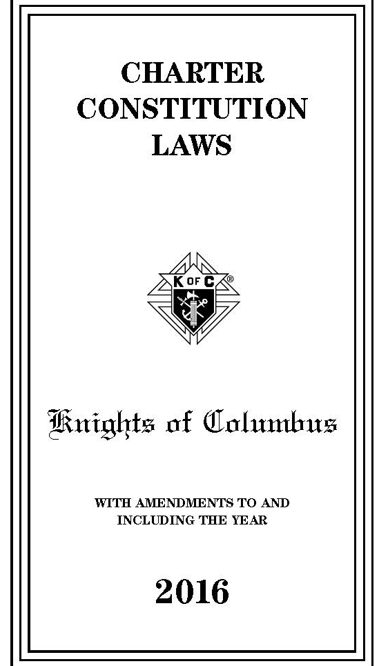
Orders' Constitution Laws
https://www.kofc.org/un/en/forms/leadership/charter-const-laws30.pdf

Slide 93
IRS Council Requirements
Councils must file Annual Tax Return (Form 990) with Internal Revenue Service
KofC is a Fraternal Benefit Society; a tax-exempt organization under Section 501(c)(8)
IRS recognizes all councils as “Fraternal Lodges.”
Councils claim Exemption from Federal Income Tax under Section 501(c)(8), only if Financial Secretary reported Council’s Employer Identification Number to the KofC Legal Dept
Legal Dept in turn must have provided it the IRS
Councils Should File Returns Directly with IRS
Group exemption does not exempt Councils from State / Local Taxes
Good News - It's the Financial Secretary Responsibility to Address!

Slide 94
Our Duty
Times change but the Challenges of the Poor remain the same:
- Food, Shelter, Warm Clothing,
Financial Security
- Aid for Widows / Orphans
Society continues to face these Challenges, but we must "Never Waiver" in continuing Fr McGivney’s Vision of
Service to the Less than Fortunate in our Parishes and Communities.

Slide 95
“Commitment is Doing
What You Said You Would Do,
After the Feeling You Said it in,
Has Passed”
- St Camillus

Slide 96
Final Thought
When We Die,
The Lord is not going to ask us, how much money did we make?
But He May Ask:
“How much did you love?"
"Did you love God above all things?"
"Did you love your neighbor, as yourself?”
What will Your Answers Be?

